Slide 1
Automobile Price Data
Submitted By: Debanjan Chowdhury

Slide 2
Objective
Check for errors in dataset
Replace them with a suitable approach and explain why you opted for that method or technique
Final Report on the dataset before and after cleaning
The final dataset need to contain only numeric column and rest of the columns need to be encoded and save it in .csv format
Find the factors which affect the price

Slide 3
Features in the dataset
Numerical Features
Feature Name | Meaning
normalized-losses | relative average loss payment per insured vehicle year.
wheel-base | horizontal distance between the centers of the front and rear wheels
length | length of the car
width | width of the car
height | height of the car
curb-weight | total mass of the car with standard equipments and all necessary operating consumables while not loaded with either passenger or cargo
engine-size | size of the engine
bore | diameter of each cylinder

Slide 4
Features in the dataset
Numerical Features
Feature Name | Meaning
stroke | distance travelled by the piston during each phase
compression-ratio | ratio of maximum to minimum volume in the cylinder of an IC engine.
horsepower | power produced by the engine
peak-rpm | maximum rounds the drive wheels can move in one minute
city-mpg | mileage in city
highway-mpg | mileage in highway
price | price of car (response variable)

Slide 5
Features in the dataset
Categorical Features
Feature Name | Meaning
symboling | insurance risk level of a car
make | manufacturing company
fuel-type | type of fuel used by the car
aspiration | type of aspiration of the car
num-of-doors | number of doors in the car
body-style | style of the body of the car
drive-wheels | drive wheels of the car
engine-location | location of engine in the car
engine-type | type of engine in the car

Slide 6
Features in the dataset
Categorical Features
Feature Name | Meaning
num-of-cylinders | number of cylinders in the car
fuel-system | fuel system of the car

Slide 7
Errors in the dataset
There are some errors in the dataset. They are :
1. Certain columns have '?' in place of values. These columns are:
a. normalized-losses
b. num-of-doors
c. bore
d. stroke
e. peak-rpm
f. price
g. horsepower
Therefore we need to use certain imputation techniques in order to fillup the missing values.

Slide 8
Errors in the dataset
2. Certain columns have object as datatype which should not be. These columns are :
a. normalized-losses (float64)
b. stroke (float64)
c. horsepower (float64)
d. peak-rpm (float64)
e. price (float64)
f. bore (float64)
Therefore we need to convert the columns first to their respective datatypes.

Slide 9
What did I do with the columns with '?'
Firstly I checked all the numerical columns such as 'normalized-losses', 'bore', 'stroke', 'peak-rpm', 'price', 'horsepower' for any outliers. For this I plotted boxplot for all the columns. For those columns, which had outliers, I filled up the missing values with their median values and for those who didn't, I filled up the missing values with their mean value.
Then for the categorical column ('num-of-doors') I filled the missing values with the mode of that column.

Slide 10
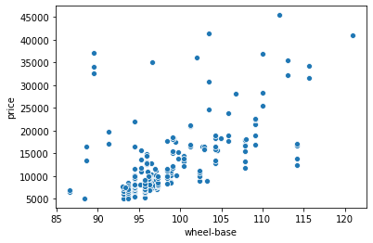
Overall Data Analysis (Numerical Features)
wheel-base
We can see that as the wheel-base value increases, the price of car increases. It means it has a positive correlation with the price (0.584847).

Slide 11
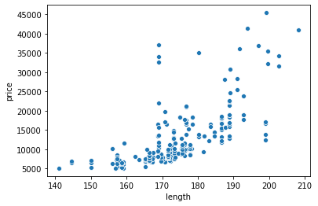
Overall Data Analysis (Numerical Features)
length
We can see that as the length value increases, the price of car increases. It means it has a positive correlation with the price (0.686567).

Slide 12
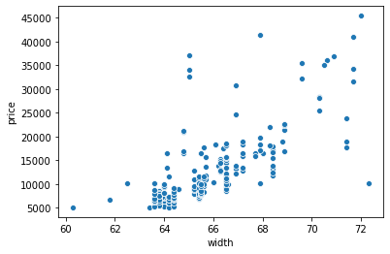
Overall Data Analysis (Numerical Features)
width
We can see that as the width value increases, the price of car increases. It means it has a positive correlation with the price (0.724558).

Slide 13
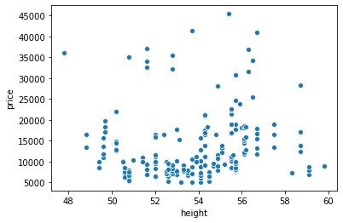
Overall Data Analysis (Numerical Features)
height
We can see that as the height value increases, the price of car increases. It means it has a positive correlation (although weak) with the price (0.140439).

Slide 14
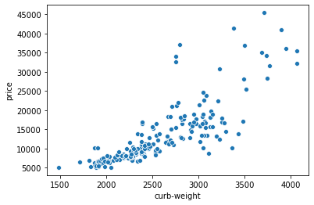
Overall Data Analysis (Numerical Features)
curb-weight
We can see that as the curb-weight value increases, the price of car increases. It means it has a positive correlation with the price (0.819817).

Slide 15
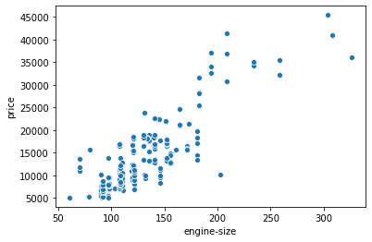
Overall Data Analysis (Numerical Features)
engine-size
We can see that as the engine-size value increases, the price of car increases. It means it has a positive correlation with the price (0.860343).

Slide 16
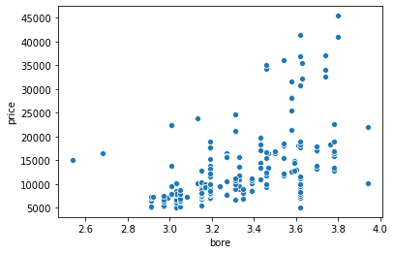
Overall Data Analysis (Numerical Features)
bore
We can see that as the bore value increases, the price of car increases. It means it has a positive correlation with the price (0.532865).

Slide 17
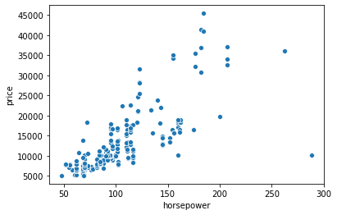
Overall Data Analysis (Numerical Features)
horsepower
We can see that as the horsepower value increases, the price of car increases. It means it has a positive correlation with the price (0.749919).

Slide 18
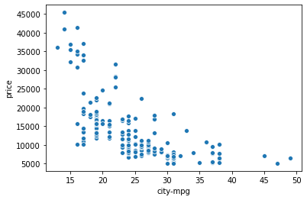
Overall Data Analysis (Numerical Features)
city-mpg
We can see that as the city-mpg value increases, the price of car decreases. It means it has a negative correlation with the price (-0.668822).

Slide 19
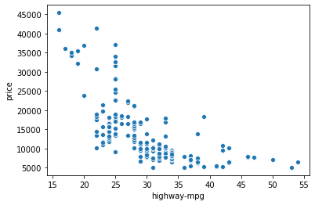
Overall Data Analysis (Numerical Features)
highway-mpg
We can see that as the highway-mpg value increases, the price of car decreases. It means it has a negative correlation with the price (-0.693037).

Slide 20
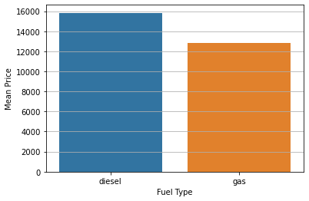
Overall Data Analysis (Categorical Features)
fuel-type
We can see that the mean price of car with diesel is higher than that with gas.
fuel-type | price
diesel | 15838.15
gas | 12859.73

Slide 21
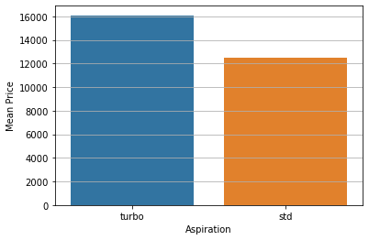
Overall Data Analysis (Categorical Features)
aspiration
We can see that the mean price of car with turbo is higher than that with std.
aspiration | price
turbo | 16093.73
std | 12502.05

Slide 22
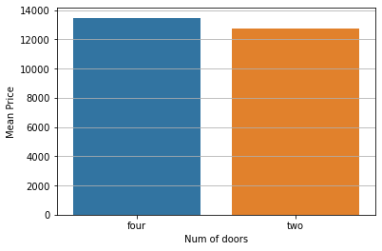
Overall Data Analysis (Categorical Features)
num-of-doors
We can see that the mean price of car with four doors is higher than that with two doors.
num-of-doors | price
four | 13470.42
two | 12733.08

Slide 23
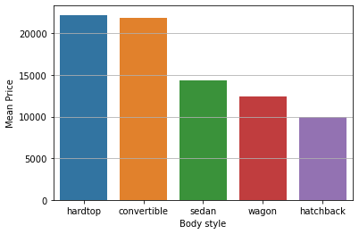
Overall Data Analysis (Categorical Features)
body-style
We can see that the mean price of car with hardtop is highest and with hatchback is least.
body-style | price
hardtop | 22208.5
convertible | 21890.5
sedan | 14372.99
wagon | 12371.96
hatchback | 9967.09

Slide 24
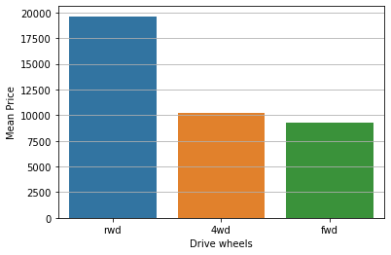
Overall Data Analysis (Categorical Features)
drive-wheels
We can see that the mean price of car with rwd is highest and with fwd is lowest.
drive-wheels | price
rwd | 19633.11
4wd | 10247
fwd | 9262.28

Slide 25
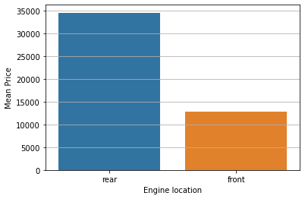
Overall Data Analysis (Categorical Features)
engine-location
We can see that the mean price of car with rear engine location is higher than that with front engine location.
engine-location | price
rear | 34528
front | 12832.82

Slide 26
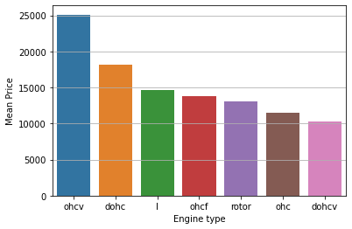
Overall Data Analysis (Categorical Features)
engine-type
We can see that the mean price of car with ohcv engine type is the highest and with dohcv engine type the price is the least.
engine-type | price
ohcv | 25098.38
dohc | 18116.42
I | 14627.58
ohcf | 13738.6
rotor | 13020
ohc | 11541.57
dohcv | 10295

Slide 27
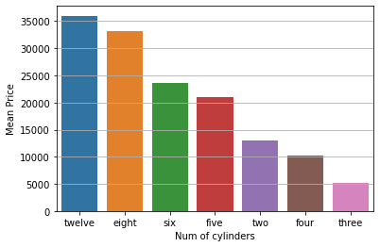
Overall Data Analysis (Categorical Features)
num-of-cylinders
We can see that the mean price of car with twelve cylinders is the highest and with three cylinders is the least.
fuel-type | price
twelve | 36000
eight | 33179
six | 23671.83
five | 20942.82
two | 13020
four | 10303.1
three | 5151

Slide 28
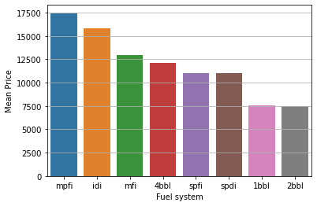
Overall Data Analysis (Categorical Features)
fuel-system
We can see that the mean price of car with mpfi fuel type is the highest and with 2bbl fuel type, it is the least
fuel-type | price
mpfi | 17449.61
idi | 15838.15
mfi | 12964
4bbl | 12145
spfi | 11048
spdi | 10990.44
1bbl | 7555.55
2bbl | 7519.92

Slide 29
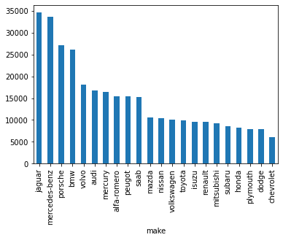
Overall Data Analysis (Categorical Features)
make
make | price
jaguar | 34600
mercedes-benz | 33647
porsche | 27179.4
bmw | 26118.75
volvo | 18063.18
audi | 16778.57
mercury | 16503
alfa-romero | 15498.33
peugot | 15489.1
saab | 15223.33

Slide 30
Overall Data Analysis (Categorical Features)
make
make | price
mazda | 10652.88
nissan | 10415.67
volkswagen | 10077.5
toyota | 9885.81
isuzu | 9605.75
renault | 9595
mitsubishi | 9239.77
subaru | 8541.25
honda | 8184.69
plymouth | 7963.43

Slide 31
Overall Data Analysis (Categorical Features)
make
We can see that chevrolet has the
least mean price while jaguar has the
max mean price.
make | price
dodge | 7875.44
chevrolet | 6007

Slide 32
Further Analysis...
For further analysis, I grouped the entire data based on the price
Low Price ( <10,000)
Medium Price (>=10,000 to <20,000)
High Price (>=20,000)

Slide 33
Comparison of different groups(Numerical Features)
Groups | wheel-base | length | width | height | curb-weight | engine-size | bore | horsepower | city-mpg | highway-mpg
High price | 101.2-106.7 | 180.3-197 | 66.9-70.6 | 52.8-55.9 | 3012-3740 | 164-234 | 3.46-3.74 | 123-182 | 16-21 | 19-25
medium price | 96.0-104.3 | 173.5-186.7 | 65.7-67.8 | 52-56.1 | 2501.75-3052 | 120-152 | 3.27-3.62 | 95-145 | 19-24 | 24-30
low price | 93.7-96.5 | 158.1-172 | 63.8-65.4 | 51.6-54.5 | 1974.5-2303.5 | 92.0-109.75 | 3.03-3.31 | 68.0-88.0 | 26.0-31.0 | 32.0-38.0

Slide 34
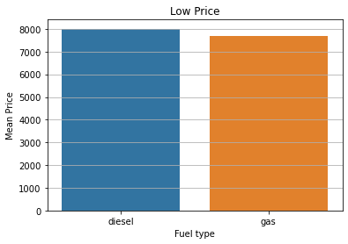
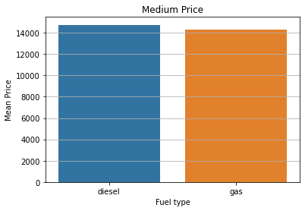
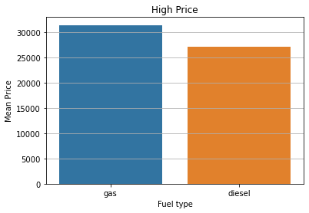
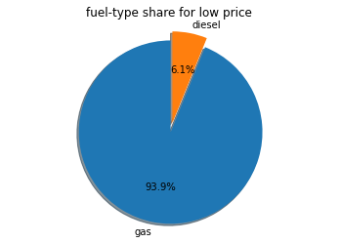
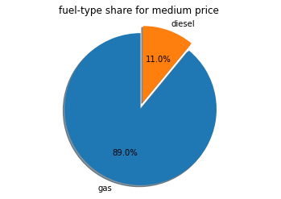
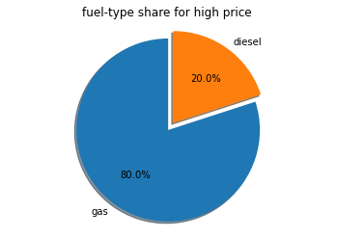
Comparison of different groups(Categorical Features)
Groups | fuel-type (mean price) |  | fuel-type (share percent)
 | diesel | gas | diesel | gas
high | 27209.2 | 31429.1 | 20% | 80%
medium | 14740.78 | 14301.92 | 11% | 89%
low | 8008.33 | 7678.57 | 20% | 80%

Slide 35
For high price data:
gas fuelled cars have high price (31429.1) whereas diesel fuelled cars have low price (27209.2).
gas fuelled cars are more (80%) whereas diesel fuelled cars are less (20%).
For medium price data:
diesel fuelled cars have high price(14740.78) whereas gas fuelled cars have low price (14301.92).
gas fuelled cars are more (89%) whereas diesel fuelled carrs are less (11%).
For low price data:
diesel fuelled cars have more price (8008.33) than gas fuelled cars (7678.57).
gas fuelled cars are more (80%) whereas diesel fuelled carrs are less (20%).

Slide 36
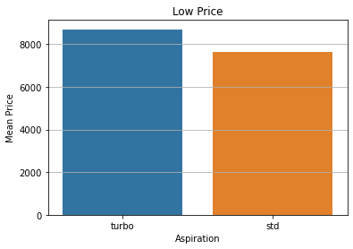
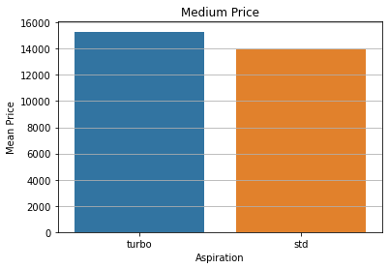
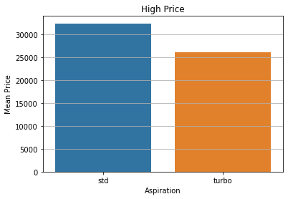
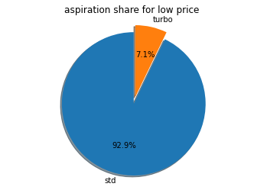
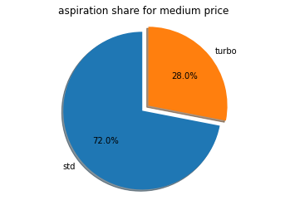

Comparison of different groups(Categorical Features)
Groups | aspiration (mean price) |  | aspiration (share percent)
 | turbo | std | turbo | std
high | 26078 | 32337 | 28% | 72%
medium | 15305.57 | 13977.61 | 28% | 72%
low | 8699.14 | 7621.80 | 7.1% | 92.9%

Slide 37
For high price data:
std aspired cars have high price (32337) whereas turbo aspired cars have low price (26078).
std aspired cars are more (72%) whereas turbo aspired cars are less (28%).
For medium price data:
turbo aspired cars have high price(15305.57) whereas std aspired cars have low price (13977.61).
std aspired cars are more (72%) whereas turbo aspired carrs are less (28%).
For low price data:
turbo aspired cars have more price (8699.14) than std aspired cars (7621.80).
std aspired cars are more (92.9%) whereas turbo aspired cars are less (7.1%).

Slide 38
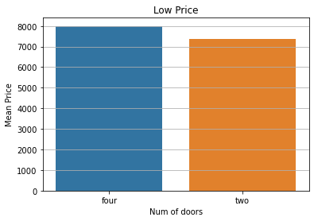
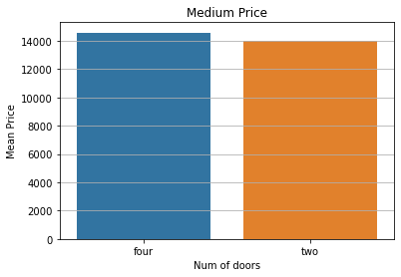
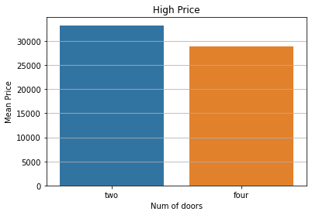
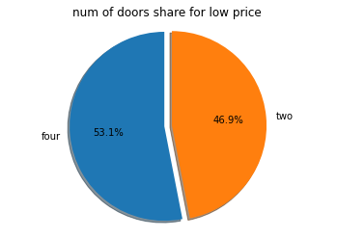
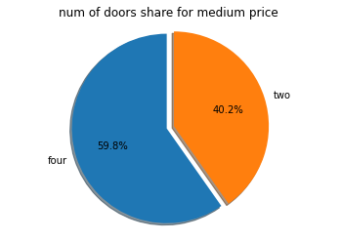

Comparison of different groups(Categorical Features)
Groups | num-of-doors (mean price) |  | num-of-doors (share percent)
 | two | four | two | four
high | 33251.9 | 28807.27 | 40% | 60%
medium | 14007.61 | 14580.73 | 40.2% | 59.8%
low | 7358.13 | 8000.08 | 46.9% | 53.1%

Slide 39
For high price data:
two door cars have high price (33251.9) whereas four door cars have low price (28807.27).
four door cars are more (60%) whereas two door cars are less (40%).
For medium price data:
four door cars have high price(14580.73) whereas two door cars have low price (14007.61).
four door cars are more (59.8%) whereas two door cars are less (40.2%).
For low price data:
four door cars have more price (8000.08) than two cars (7358.13).
four door cars are more (53.1%) whereas two door cars are less (46.9%).

Slide 40
Comparison of different groups(Categorical Features)
Groups | body-style (mean price) |  |  |  |  | body-style (share percent)
 | convertible | wagon | sedan | hatchback | hardtop | convertible | wagon | sedan | hatchback | hardtop
high | 36042 | 28248 | 29538 | 22018 | 35033 | 8% | 4% | 68% | 4% | 16%
medium | 14814.75 | 14784.69 | 14528.47 | 13921.77 | 11199 | 4.9% | 15.9% | 46.3% | 31.7% | 1.2%
low | _______ | 8077.27 | 7940.95 | 7295.63 | 8779 | _____ | 11.2% | 41.8% | 43.9% | 3%

Slide 41
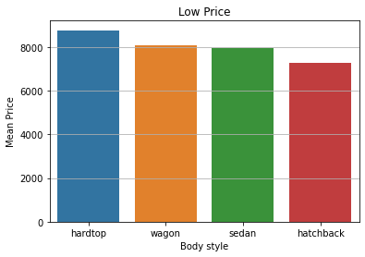
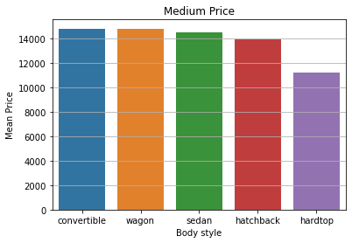
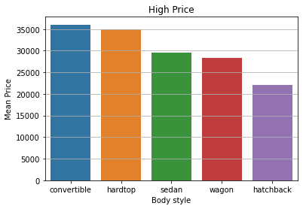
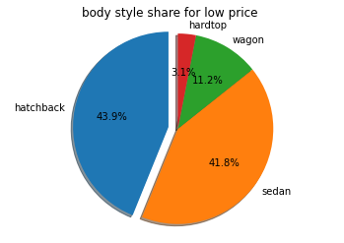
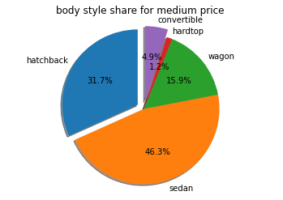
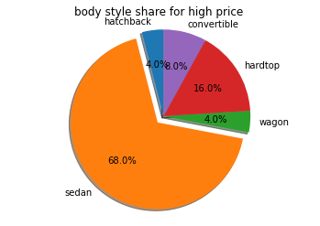
Comparison of different groups(Categorical Features)

Slide 42
For high price data:
convertible cars have high price (36042) whereas hatchback cars have low price (22018).
sedan cars are more (68%) whereas wagon & hatchback cars are less (4%).
For medium price data:
convertible cars have high price(14814.75) whereas hardtop cars have low price (11199).
sedan cars are more (46.3%) whereas hardtop cars are less (1.2%).
For low price data:
hardtop cars have more price (8779) than hatchback cars (7295.63).
hatchback cars are more (43.9%) whereas hardtop cars are less (3%).

Slide 43
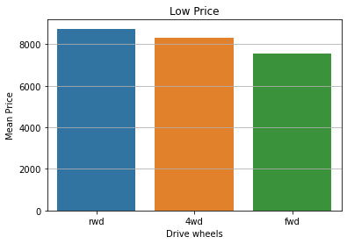
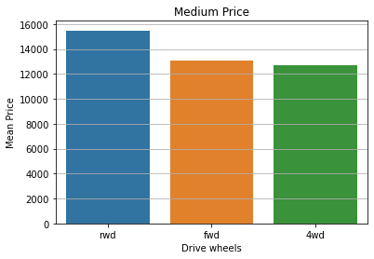
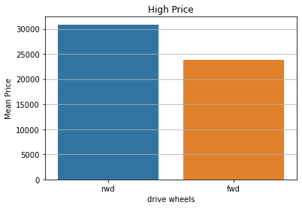
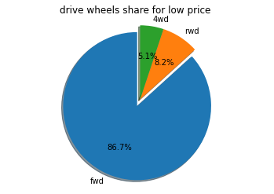
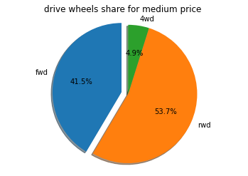
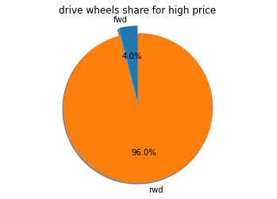
Comparison of different groups(Categorical Features)
Groups | drive-wheels (mean price) |  |  | drive-wheels (share percent)
 | rwd | fwd | 4wd | rwd | fwd | 4wd
high | 30864.71 | 23875 | ____ | 96% | 4% | ____
medium | 15485.66 | 13077.65 | 12674.5 | 53.7% | 41.5% | 4.9%
low | 8749.25 | 7564.22 | 8305 | 8.2% | 86.7% | 5.1%

Slide 44
For high price data:
rwd cars have high price (30864.71) whereas fwd cars have low price (23875).
rwd cars are more (96%) whereas fwd cars are less (4%).
For medium price data:
rwd cars have high price(15485.66) whereas 4wd cars have low price (12674.5).
rwd cars are more (53.7%) whereas 4wd cars are less (4.9%).
For low price data:
rwd cars have more price (8749.25) than fwd cars (7564.22).
fwd cars are more (86.7%) whereas 4wd cars are less (5.1%).

Slide 45
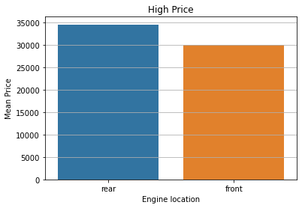

Comparison of different groups(Categorical Features)
Groups | engine-location (mean price) |  | engine-location (share percent)
 | front | rear | front | rear
high | 30047.45 | 34528 | 88% | 12%
medium | 14350.1 | ______ | 100% | _______
low | 7698.76 | ______ | 100% | _______

Slide 46
Comparison of different groups(Categorical Features)
Groups | engine-type (mean price) |  |  |  |  |  |  | engine-type (share percent)
 | dohc | ohcv | l | ohc | rotor | ohcf | dohcv | dohc | ohcv | l | ohc | rotor | ohcf | dohcv
high | 33900 | 35514.17 | ____ | 27154.21 | ___ | 34582 | ___ | 8% | 24% | ___ | 56% | ___ | 12% | ___
medium | 16345.13 | 16170.57 | 15489.1 | 13892.63 | 13020 | 1050.33 | 10295 | 9.8% | 8.5% | 13.4% | 58.5% | 4.9% | 3.7% | 1.2%
low | 9418 | ____ | 5151 | 7687.76 | ___ | 7704.89 | ___ | 2% | ____ | 1% | 87.8% | ___ | 9.2% | ___

Slide 47
For high price data:
cars with ohcv engines have high price (35514.17) whereas cars with ohc engines have low price (27154.21).
cars with ohc engines are more (56%) whereas cars with dohc engines are less (8%).
For medium price data:
rwd cars have high price(15485.66) whereas 4wd cars have low price (12674.5).
rwd cars are more (53.7%) whereas 4wd cars are less (4.9%).
For low price data:
rwd cars have more price (8749.25) than fwd cars (7564.22).
fwd cars are more (86.7%) whereas 4wd cars are less (5.1%).

Slide 48
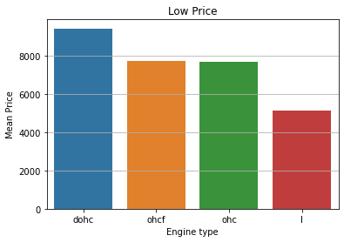





Comparison of different groups(Categorical Features)

Slide 49






Comparison of different groups(Categorical Features)

Slide 50






Comparison of different groups(Categorical Features)

Slide 51






Comparison of different groups(Categorical Features)

Slide 52
Encoding
I found that values of each of the following columns are related to each other wrt the price column. Therefore I label encoded them whereas the other categorical columns dont show any kind of relations as showed by them. Therefor i one hot encoded them.
The columns which are label encoded are :
fuel-type
aspiration
num-of-doors
drive-wheels
engine-location
num-of-cylinders
The columns which are one hot encoded are:
make
body-style
engine-type
fuel-system

